Slide 1
Auditing GenAI Models in Computer Vision
Slides by Fiona Guo
Feb. 12

Slide 2




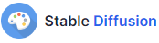
A New Generation in CV!
Generative multimodal models - tremendous growth
Text/image-to-image
Image Generation
Outpainting/Inpainting
Variations
Image-to-text
Image Captioning
Notes:
Generative multimodal models based on diffusion models have seen tremendous growth and advances in recent years and are being used for information search and retrieval along with traditional search engines.

Slide 3
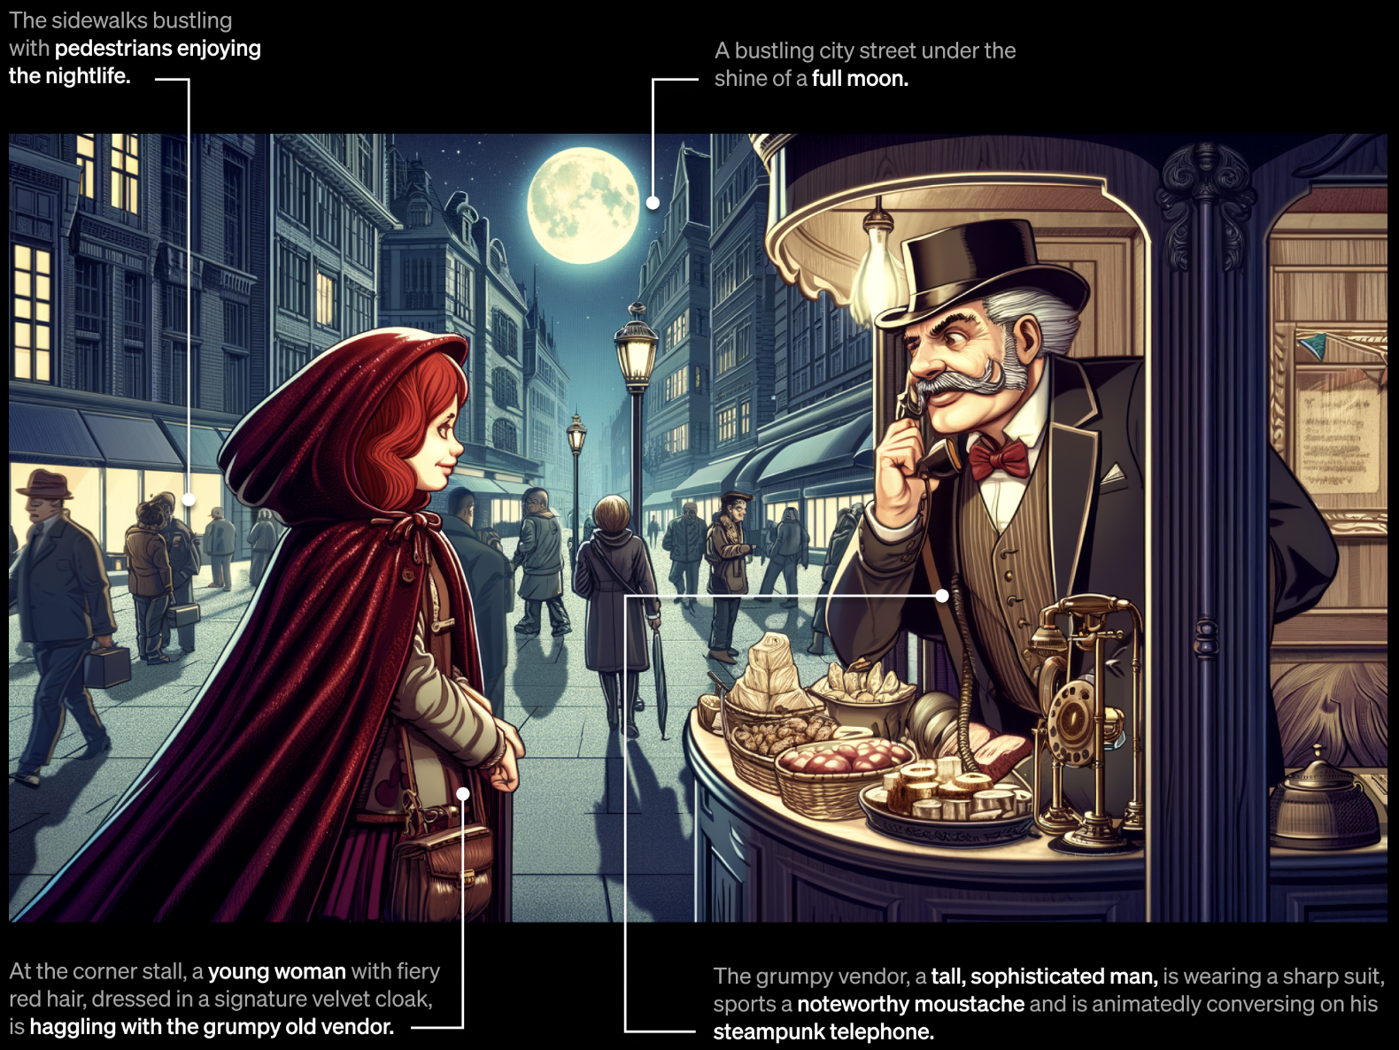
Image Generation aligned to text prompt
source: https://openai.com/dall-e-3
Notes:
From Dall-E 3
Image generation aligns quite well with the specific text prompt

Slide 4
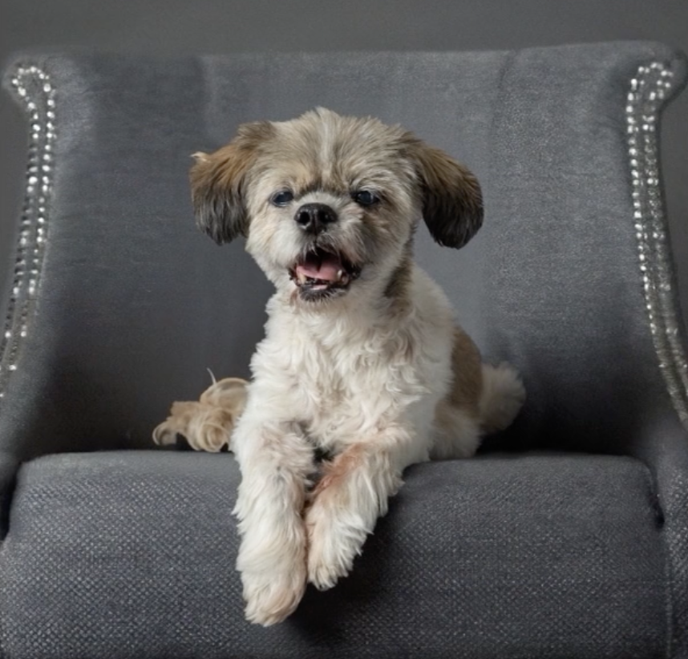
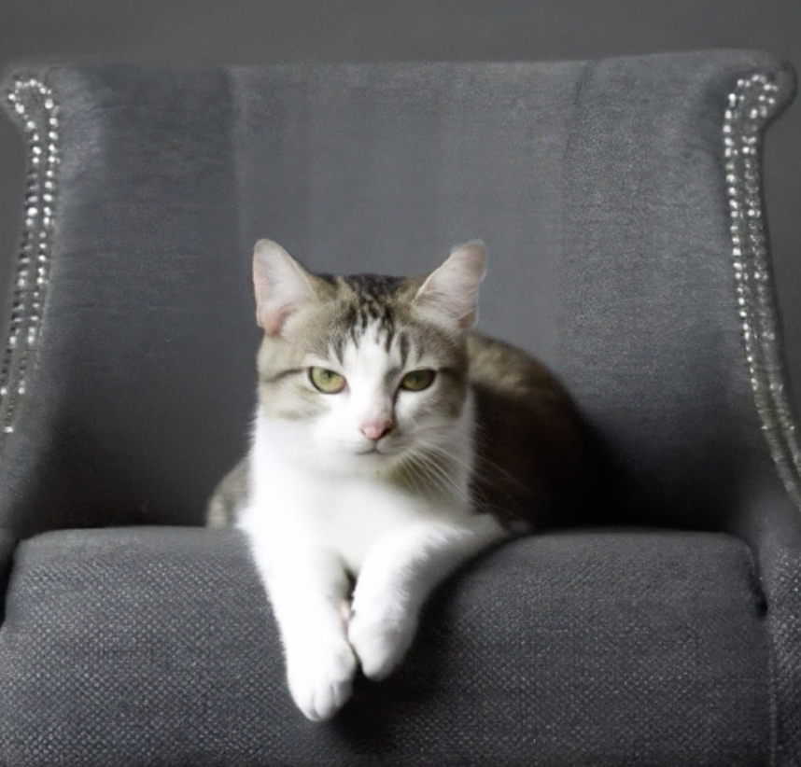
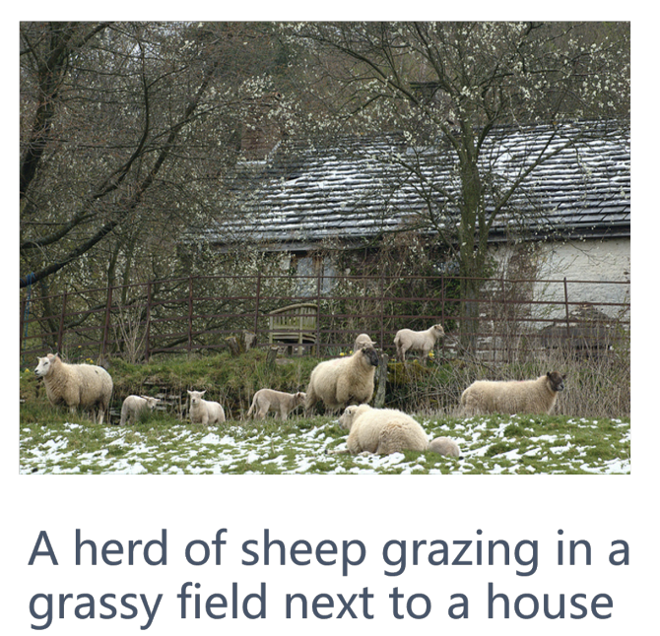
Image Variations:
Image Captioning:
Prompt:
Cute cat
source: https://openai.com/dall-e-2
[6]
Notes:
This slide gives introduction to what the image variation and captioning tasks look like

Slide 5

How does DALL-E work?
Step 1: CLIP (Contrastive Language-Image Pre-training) - Train a text encoder and an image encoder while learning the link between textual semantics and visual representations
Source: https://www.assemblyai.com/blog/how-dall-e-2-actually-works/

Slide 6
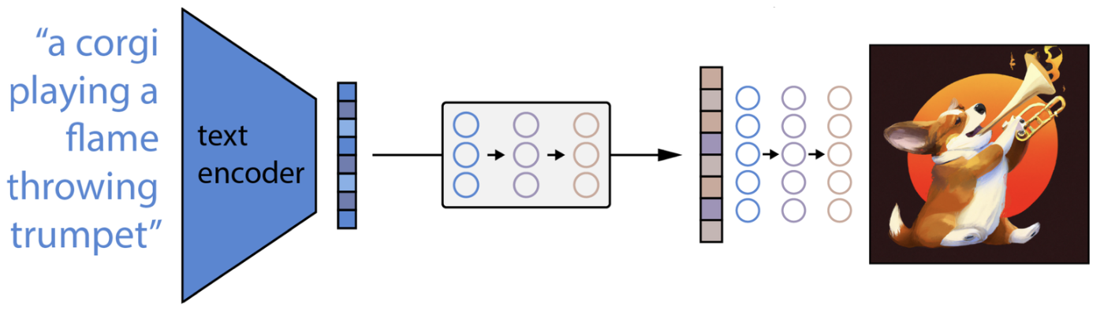
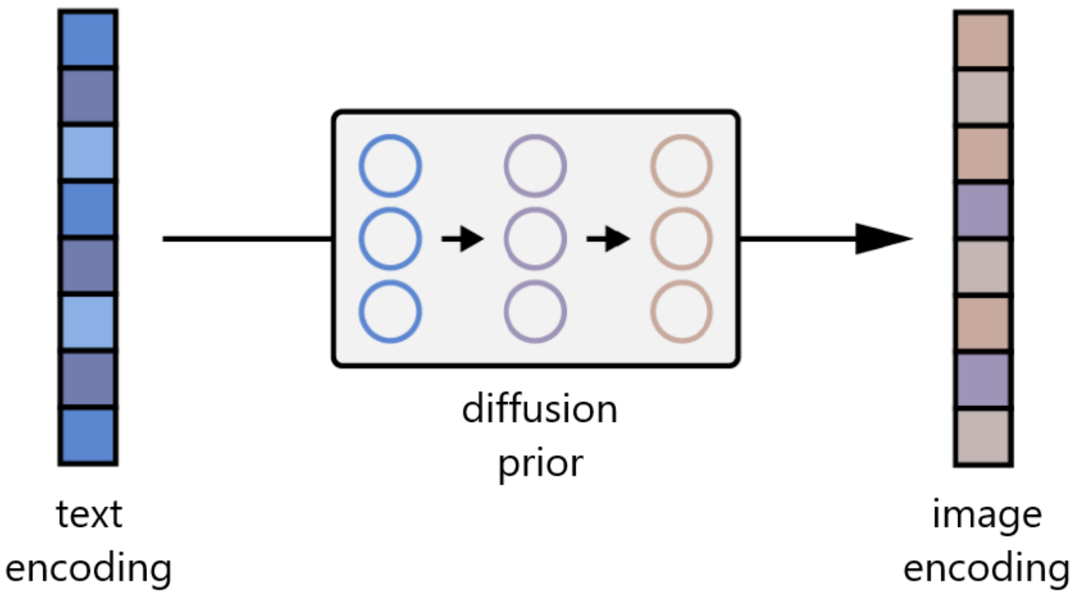
How does DALL-E work?
Step 2: Text prompt → CLIP text encoder → text encoding
Step 3: A Prior model (diffusion-based) maps text encoding to image encoding
Step 4: The GLIDE model (diffusion-based) generate image based on image encoding
Source: https://www.assemblyai.com/blog/how-dall-e-2-actually-works/

Slide 7
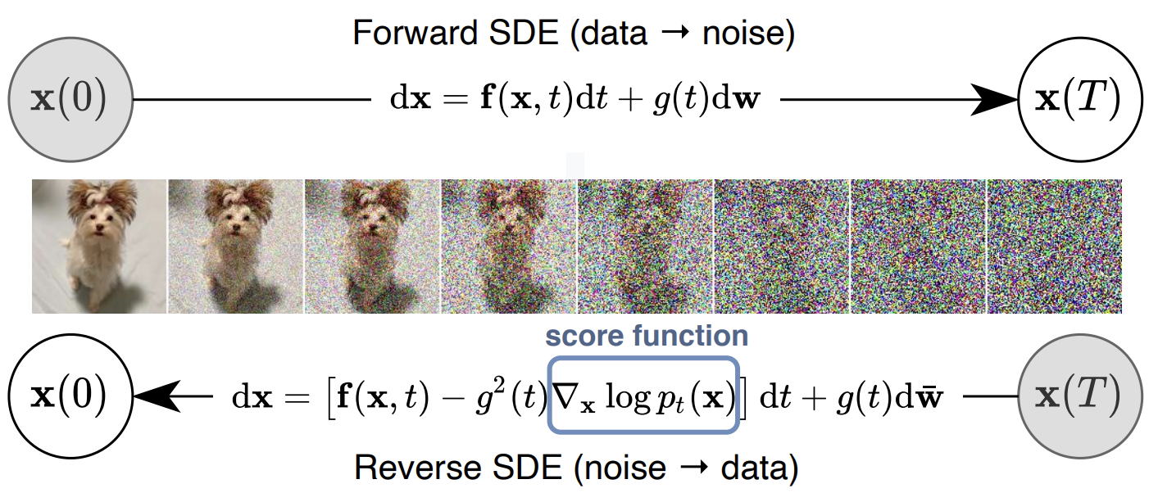
Diffusion Model
From Image to Noise is easy
From Noise to Image is Image Generation!
[7]
Notes:
Diffusion model: work by gradually adding Gaussian noise to the original data in the forward diffusion process and then learning to remove the noise in the reverse diffusion process.

Slide 8
Biases in GenAI?

Slide 9
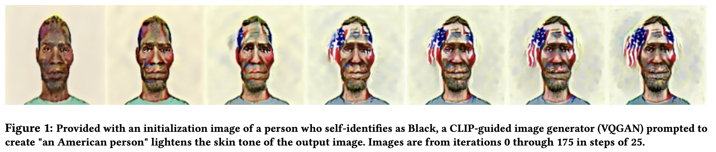
American == White??
[Wolfe, AIES 2022]
Notes:
Fig caption is self explanatory

Slide 10
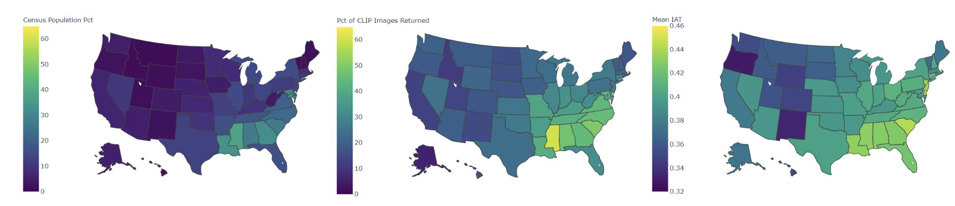
“a photo of someone who lives in [STATE]”
Separate model trained to detect race of face,
Results strongly correlate with racial makeup of each state

Slide 11
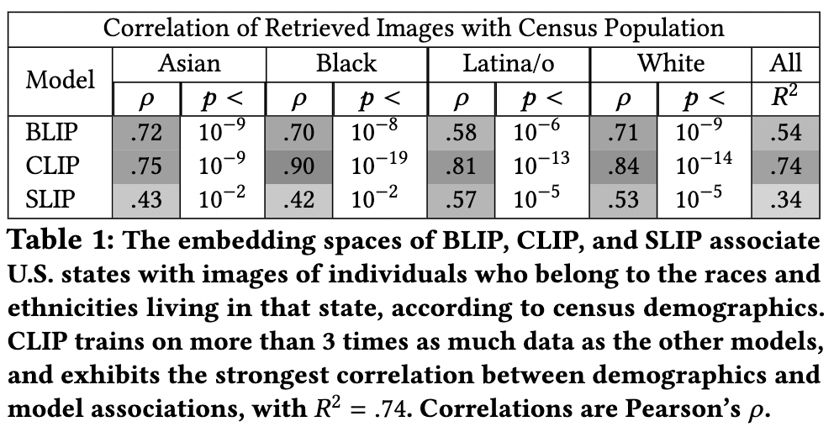

Slide 12
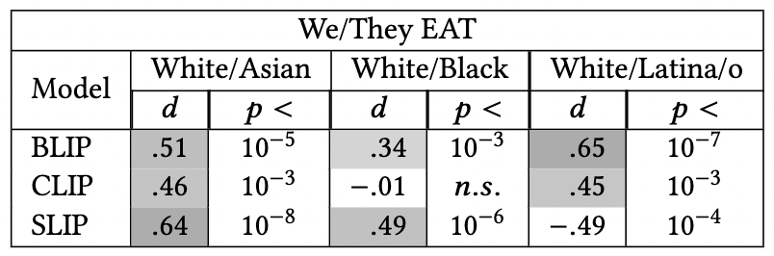
Model assumes “We” = “White” (othering)
Other findings: “white = patriotic”, “immigrant = non-white”

Slide 13
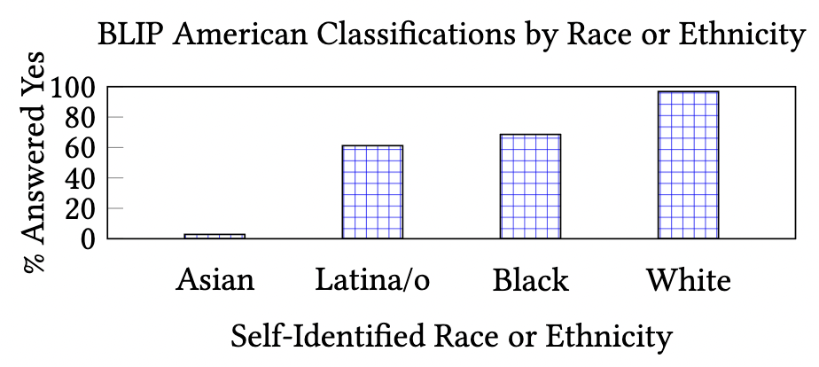
Impact on downstream tasks
“Is [FACE] American?” - White face: almost 100% labeled “yes” - Asian face: almost 100% labeled “no”

Slide 14
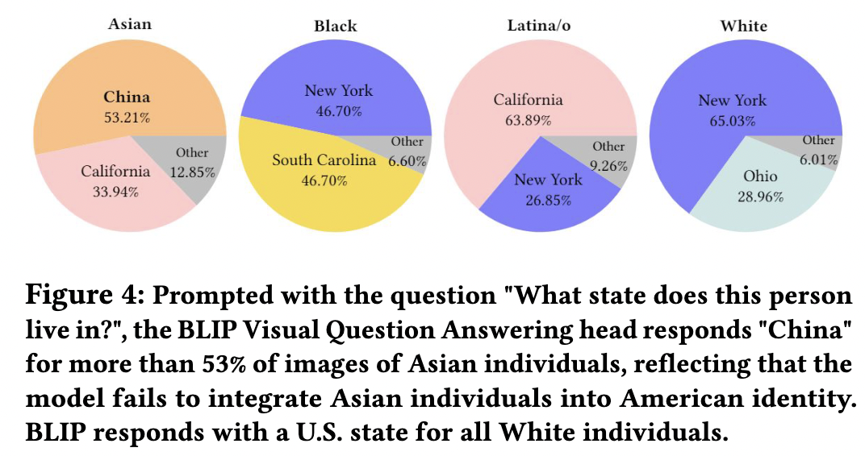

Slide 15
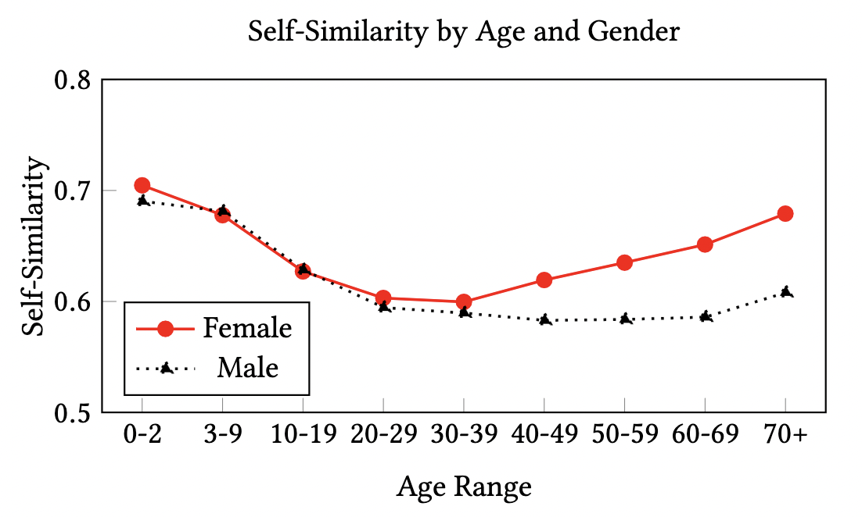
GenAI models treat older women as “all similar to each other”
[Wolfe and Caliskan, FAccT '22]

Slide 16
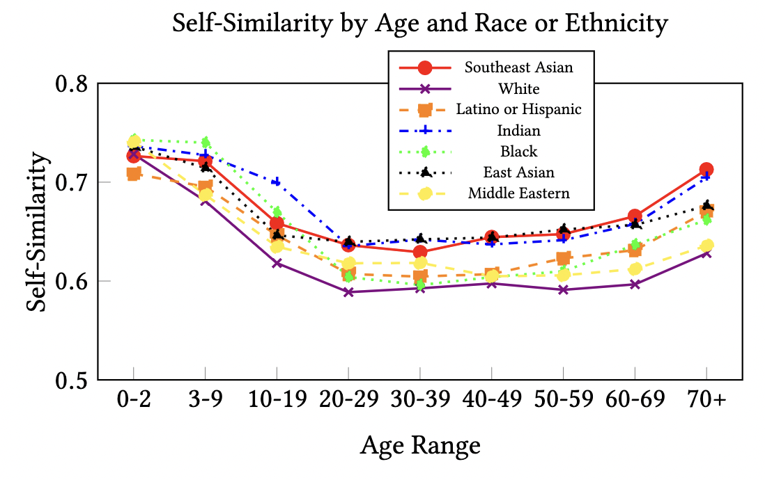
GenAI models treat non-white people as “all similar to each other”
[Wolfe and Caliskan, FAccT '22]

Slide 17
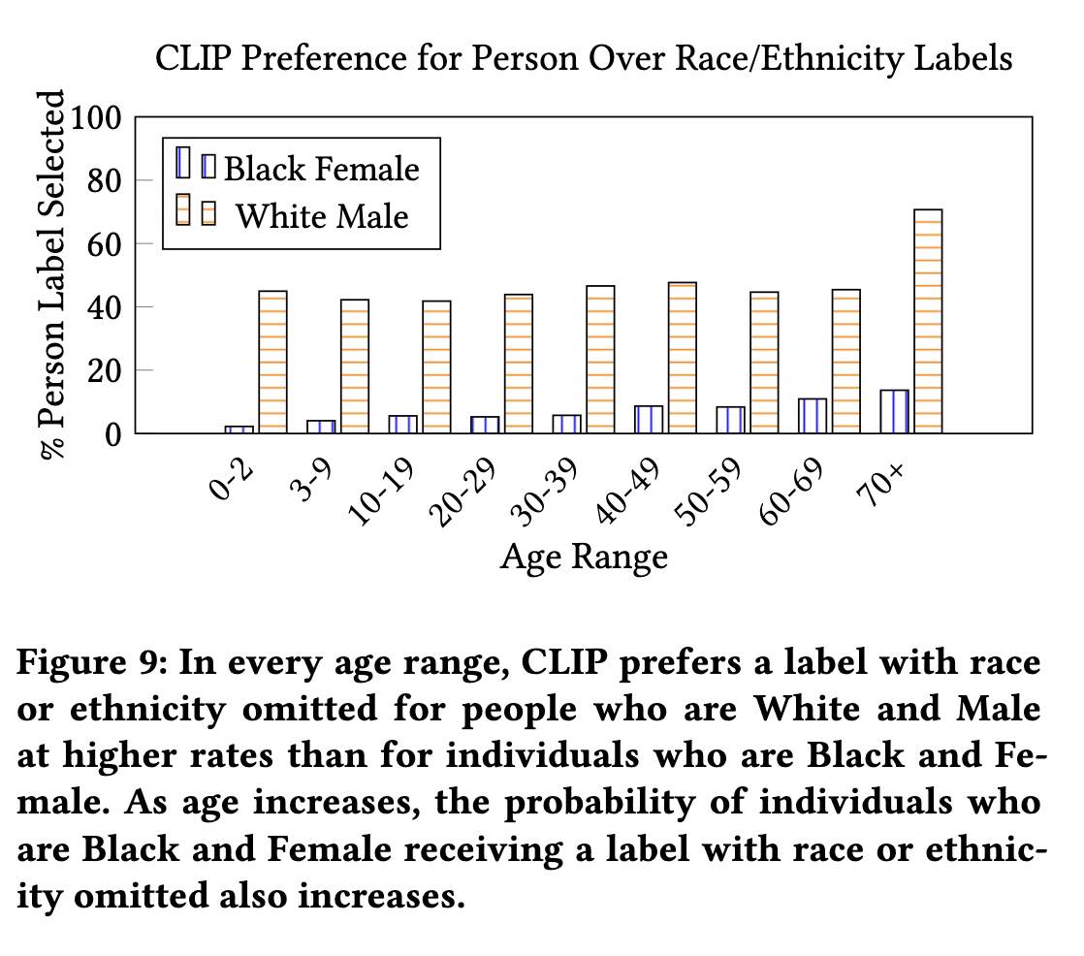
AI focuses on non-White

Slide 18
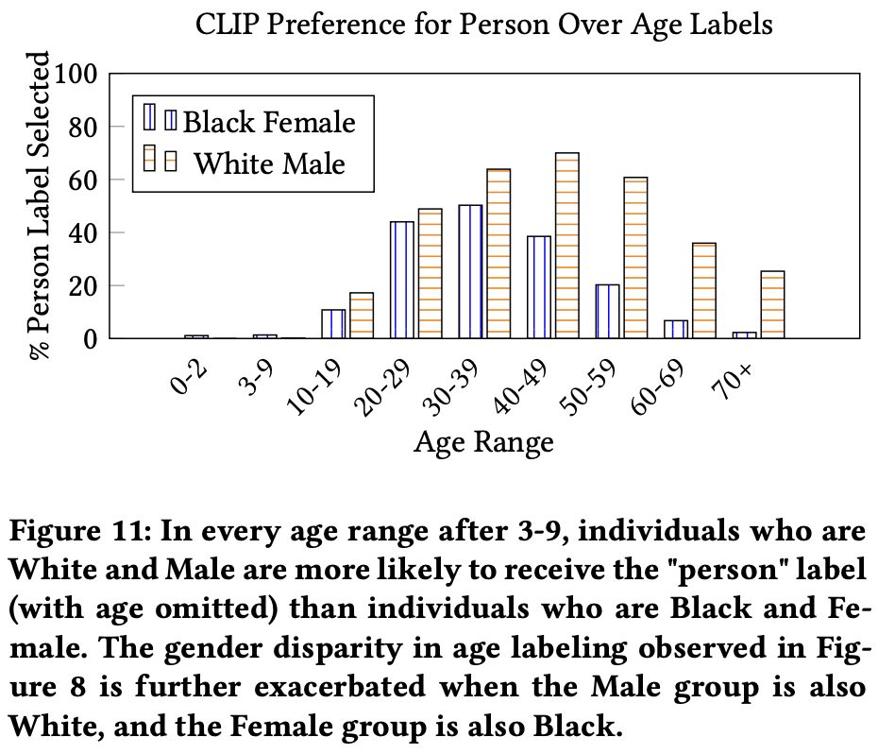
Model Prefers Older White Male
[Wolfe and Caliskan, FAccT '22]
Notes:
Analysis done on CLIP model

Slide 19
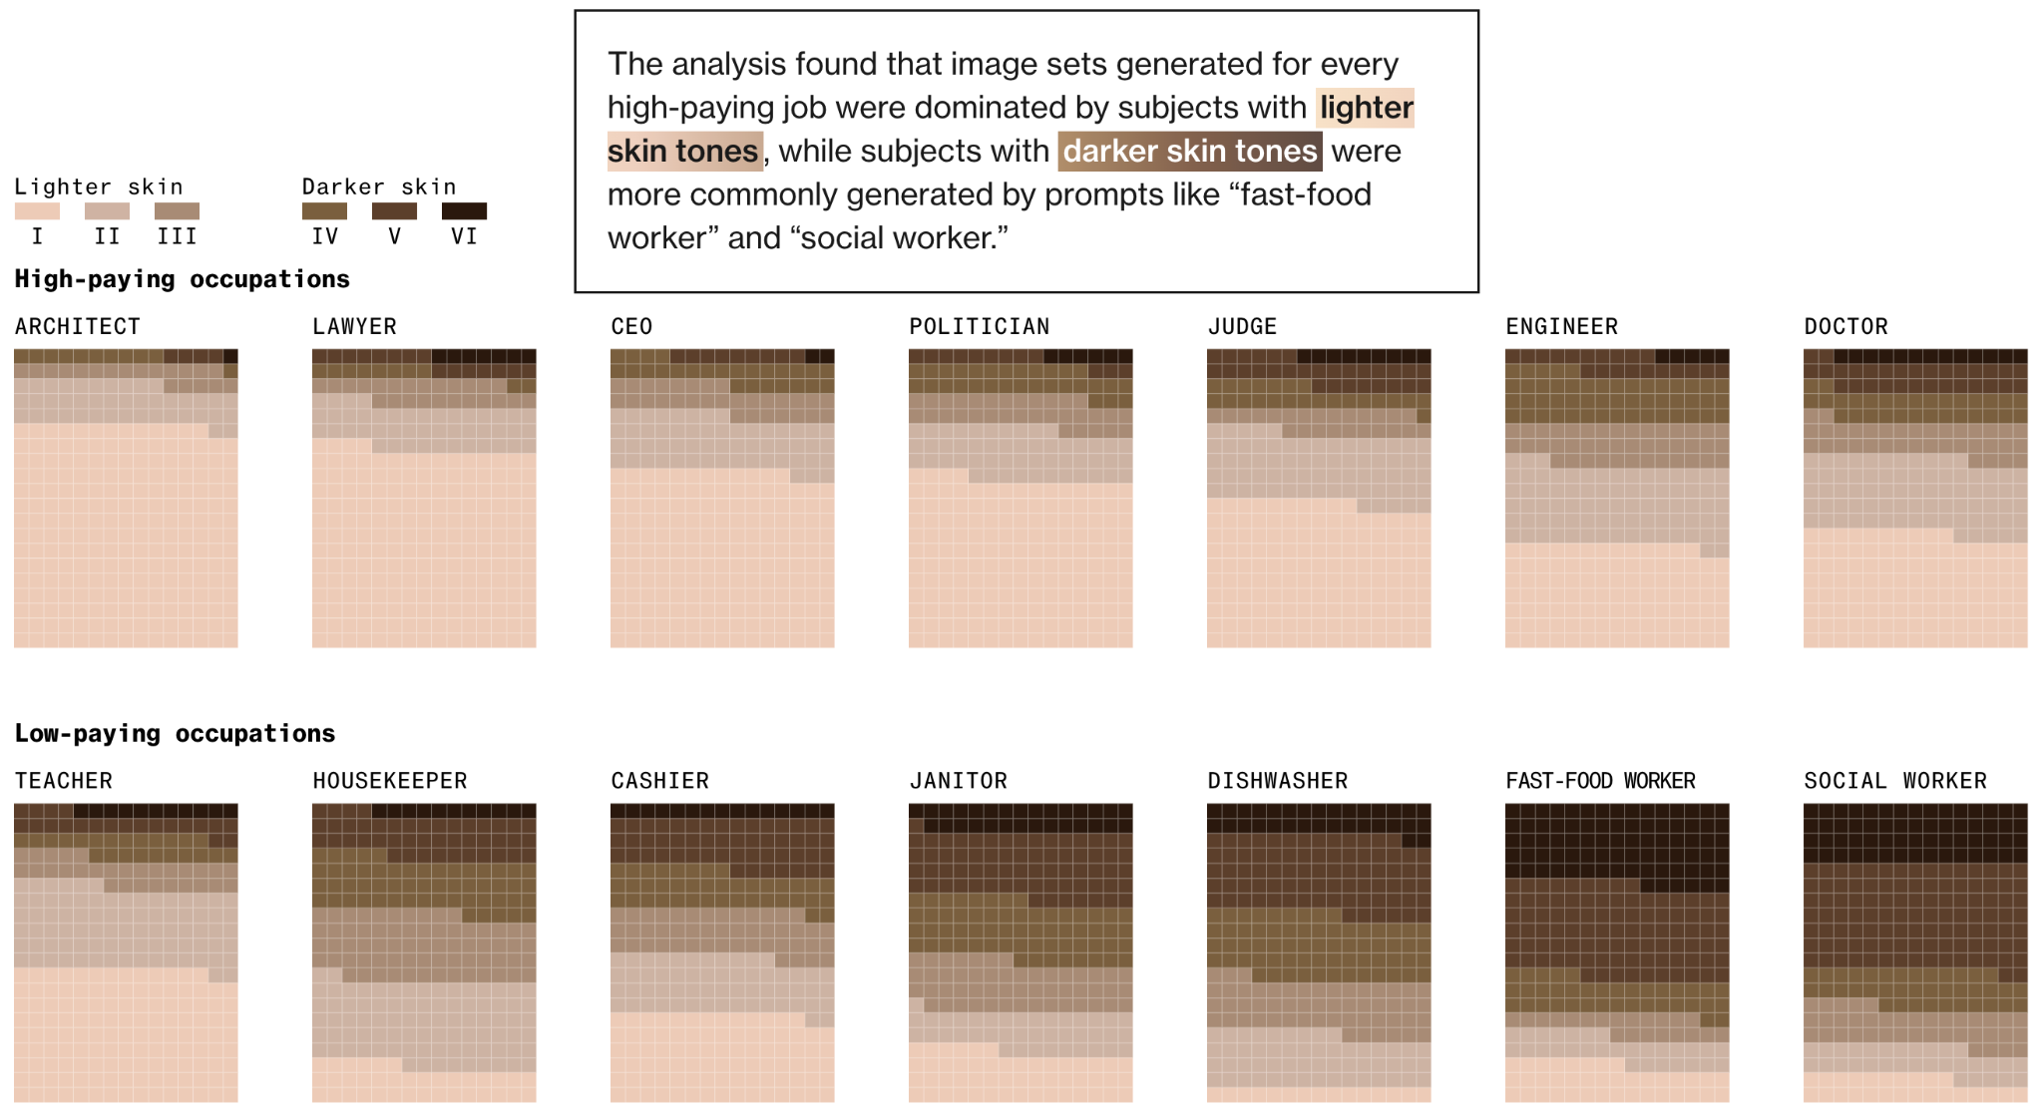
Racial Bias
Stable Diffusion
Source: https://www.bloomberg.com/graphics/2023-generative-ai-bias/
Notes:
This is an analysis done by Bloomberg, not from an academic paper. Use conclusions with caution. Nevertheless, it still shows that bias is a big potential problem for GenAI.
Bloomberg used Stable Diffusion to generate total of 5,100 images related to job titles and crime. 300 images each for 7 jobs that are typically considered “high-paying” in the US and 7 that are considered “low-paying”, plus 3 categories related to crime.
Every image was reviewed by a team of reporters and labeled according to the perceived skin color and gender of the person pictured.

Slide 20
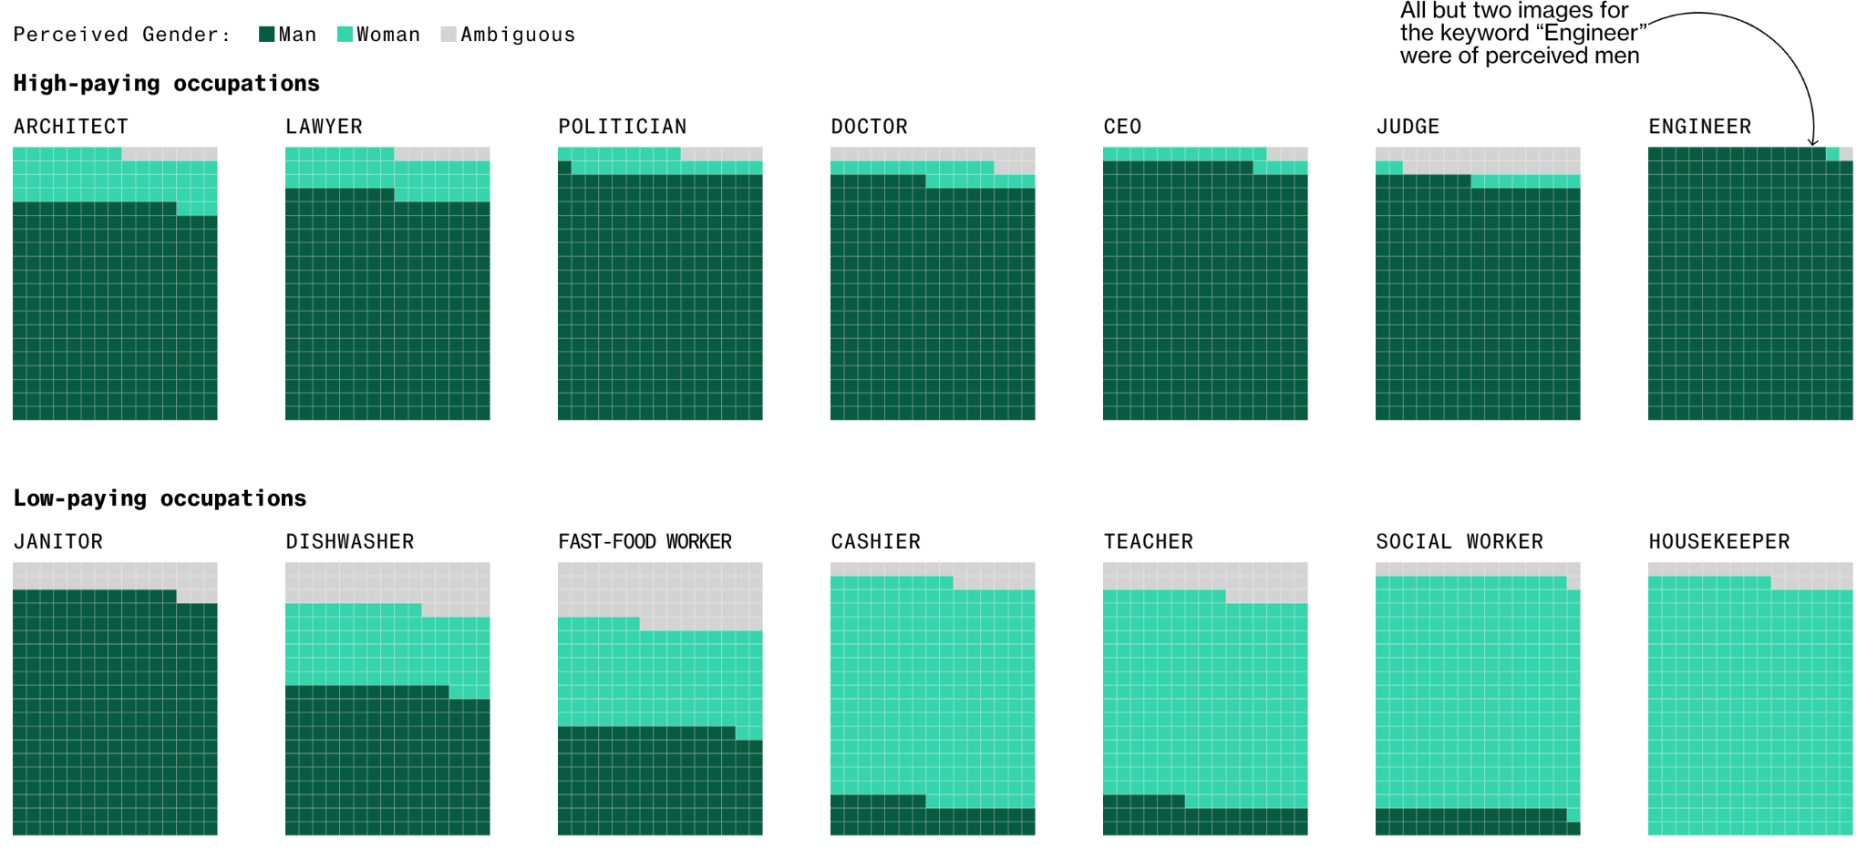
Gender Bias
Most high-paying occupations in the dataset were dominated by men, except for low-paying jobs like housekeeper and cashier.
Stable Diffusion
Source: https://www.bloomberg.com/graphics/2023-generative-ai-bias/
Notes:
For each image depicting a perceived woman, Stable Diffusion generated almost three times as many images of perceived men.

Slide 21
How to Audit Black Box Models?
Diagnostic prompts including target attributes, eg. gender profession for image generation.
Detection of attributes in generated images, using models and/or human evaluation.
Quantify bias by some metrics, compared to ideal unbiased distributions.

Slide 22
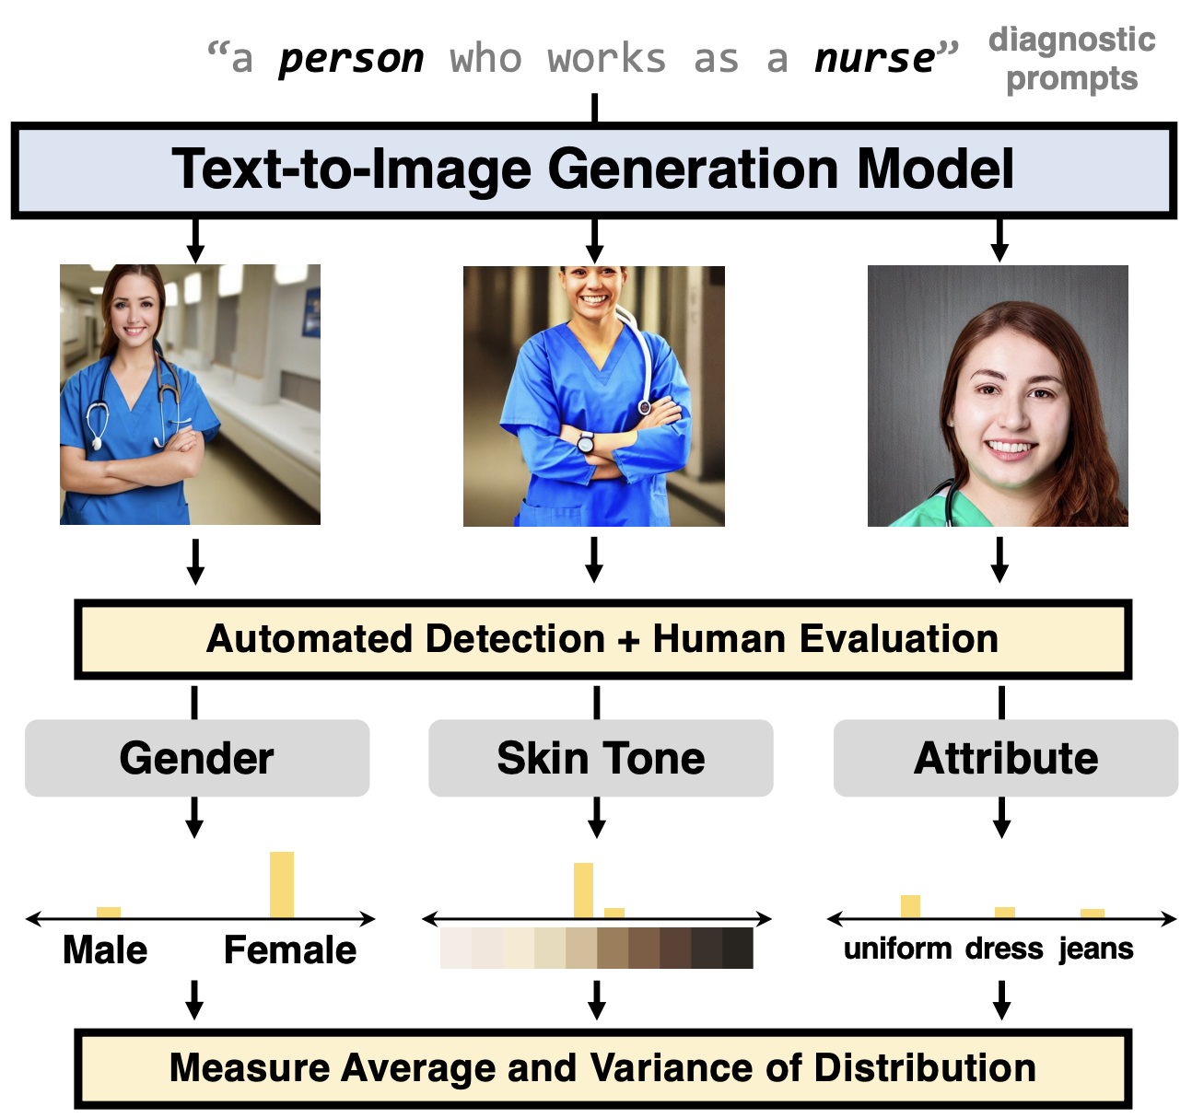
How to Measure Bias?
[Cho et al., In ICCV, 2023]
1. Diagnostic prompts (gender + profession).
2. Detection of gender, skin tone and attributes using models and human evaluation.
3. Quantify bias by average and variance.
[1]

Slide 23
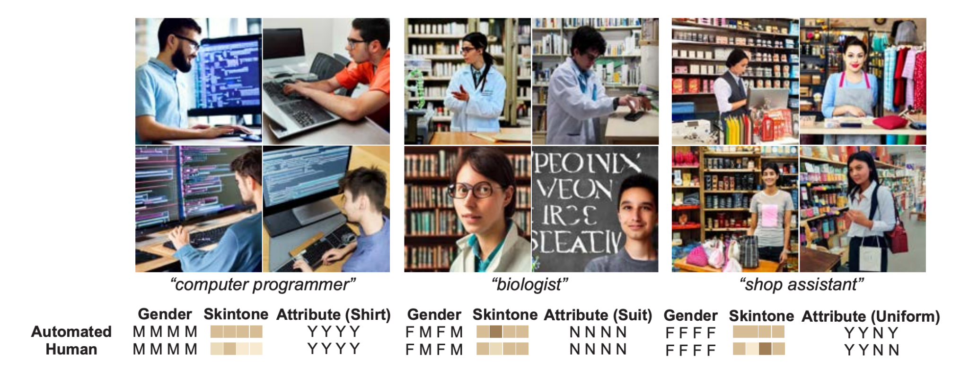
Measure Bias [Cho et al., In ICCV, 2023]
Examples generated using diagnostic prompts

Slide 24
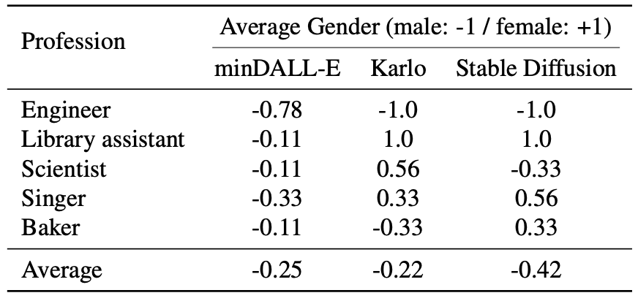
Measure Bias [Cho et al., In ICCV, 2023]
Gender
- an overall tendency to generate male images
- different gender biases in different professions
Notes:
indicating very light and dark skin tones are marginalized from the learned representation of the models

Slide 25
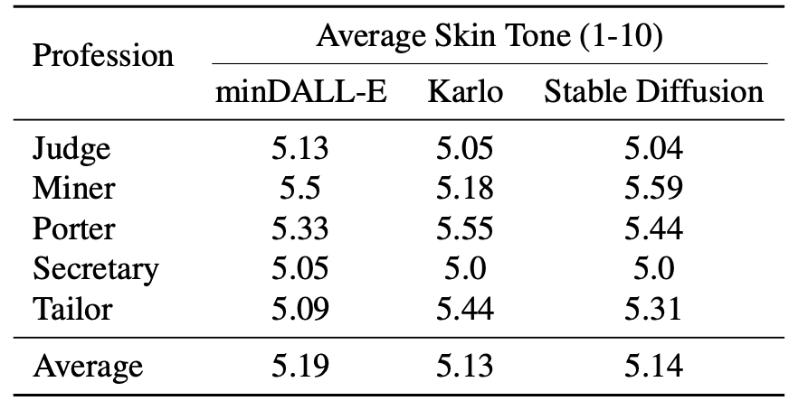
Measure Bias [Cho et al., In ICCV, 2023]
Skin Tone
- tendency to generate similar skin tones for all professions
- avg. generated skin tone between 5-6 (issue with the metric: what about very light and dark skin tones? Are all skin tones represented?)
Notes:
indicating very light and dark skin tones are marginalized from the learned representation of the models

Slide 26
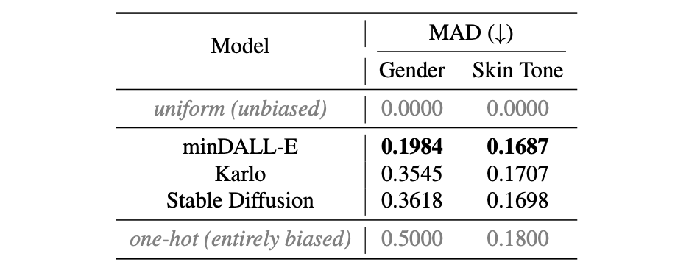
Measure Bias [Cho et al., In ICCV, 2023]
Metric: MAD (mean absolute deviation) - distance between detected gender/skin tone distribution and an unbiased uniform distribution (lower is better).
miniDALL-E has less bias in gender and skin tone

Slide 27
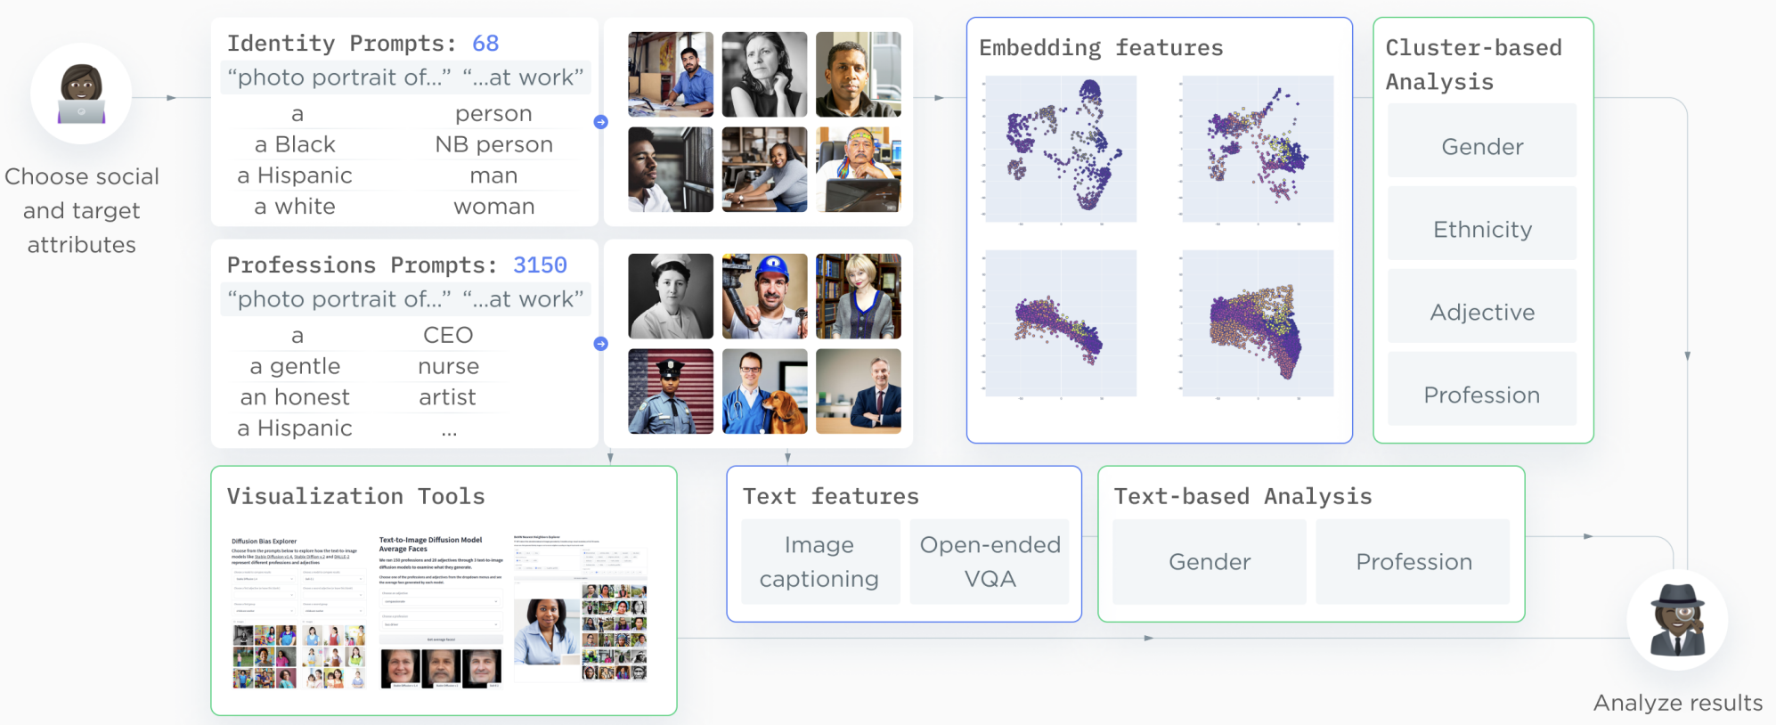
How to Measure Bias?
[Luccioni et al., Neurips, 2023]
Use the VQA model to generate image embeddings
Visual question and answering
Notes:
Diagnostic prompts including target attributes, identity and professions
Detection of attributes in generated images, using models and/or human evaluation.
Text Features Analysis: from generated image to text descriptions
Image Captioning
Visual Question Answering (VQA)
Visual Feature Analysis: clustering-based
Use the VQA model to generate image embeddings (the normalized average of the question token embeddings produced by the VQA encoder conditioned on the image)
Clustering in the embedding space

Slide 28
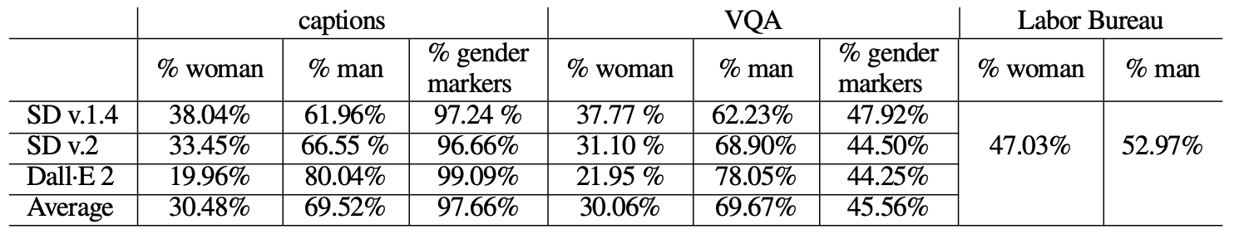
Measure Bias [Luccioni et al., Neurips, 2023]
Text Features Analysis
% Man >> % woman
More than 95% generations have gender markers (very few mention gender-neutral terms such as ‘person’, NONE use the ‘non-binary’ gender marker)
Stable diffusion

Slide 29
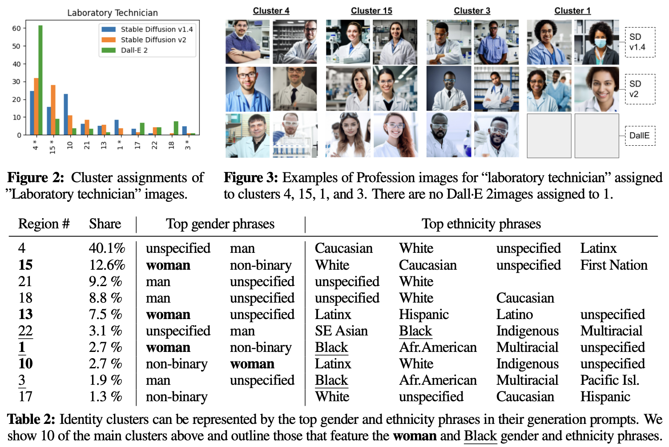
Measure Bias [Luccioni et al., Neurips, 2023]
Clustering analysis on embeddings of generated images
“Photo portrait of a laboratory technician.”
Biggest cluster: man, caucasian, white, etc
Woman and Black related attributes are of minority

Slide 30
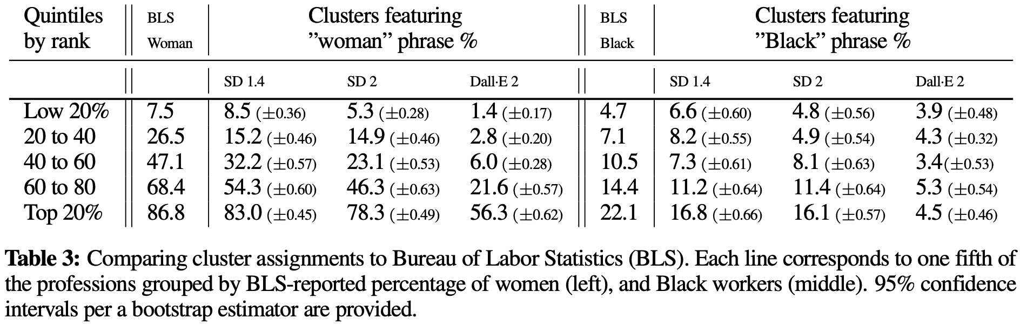
Measure Bias [Luccioni et al., Neurips, 2023]
woman and black people are under-represented across different quantiles

Slide 31
Measure Bias [Luccioni et al., Neurips, 2023]
Bias least pronounced for Stable Diffusion v1.4, and most pronounced for Dall·E 2

Slide 32
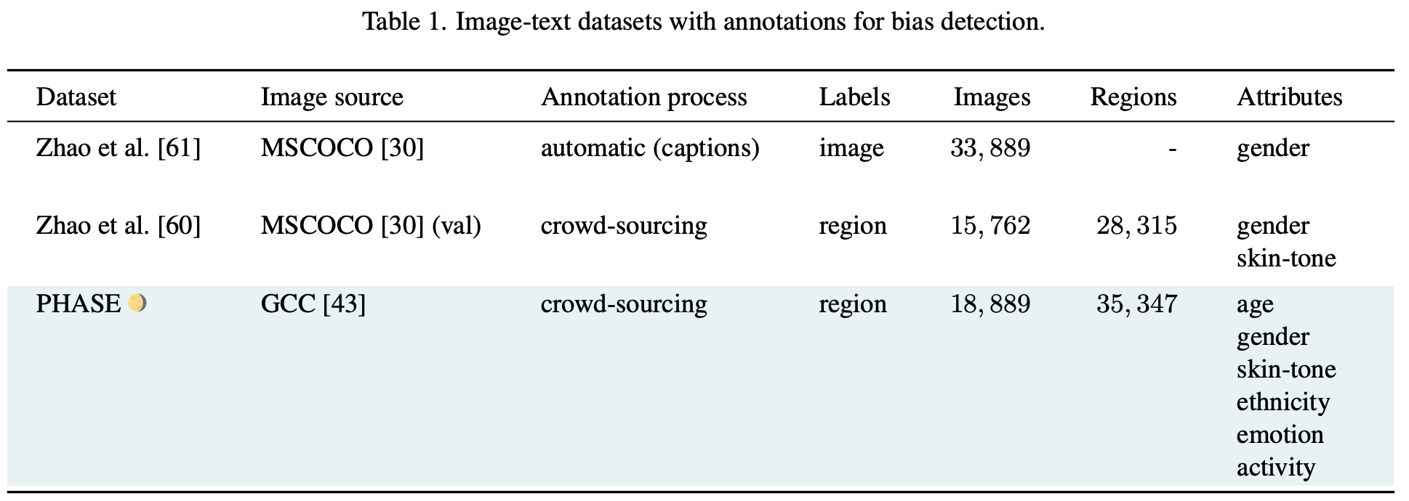
How to Mitigate Bias [Garcia et al, CVPR 2023]
More Representative, Attribute-labeled Data
Notes:
large and uncurated datasets to train vision-and-language models has raised concerns about fair representations
annotate with demographic and contextual attributes can help
In addition, it’s also necessary to conduct analysis of the annotations, focusing on how different demographic groups are represented

Slide 33
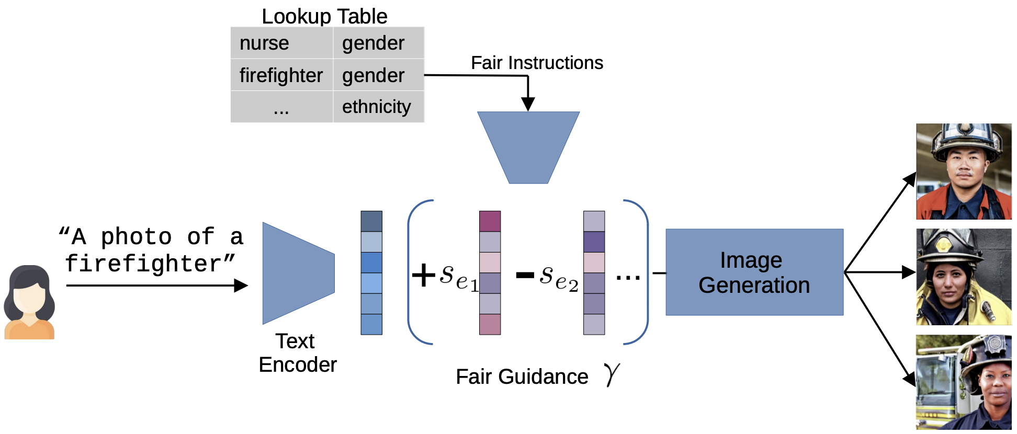
How to Mitigate Bias [Friedrich et al, 2023]
Fair Diffusion Model
Additional textual descriptions e_{i} (w/ scale and direction) to make image generations fairer on certain attributes
These additional fair instructions will be learned as embedding S_{ei}

Slide 34
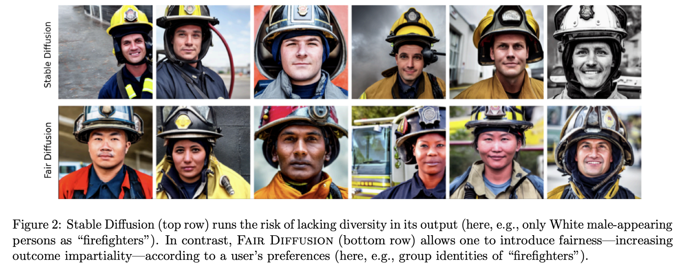
How to Mitigate Bias [Friedrich et al, 2023]
white males only
more
diversity

Slide 35
Reference
[1] https://openaccess.thecvf.com/content/ICCV2023/papers/Cho_DALL-Eval_Probing_the_Reasoning_Skills_and_Social_Biases_of_Text-to-Image_ICCV_2023_paper.pdf
[2] https://link.springer.com/chapter/10.1007/978-3-031-37249-0_2
[3] Luccioni, Sasha, et al. "Stable Bias: Evaluating Societal Representations in Diffusion Models." Thirty-seventh Conference on Neural Information Processing Systems Datasets and Benchmarks Track. 2023. https://arxiv.org/abs/2303.11408
[4] https://openaccess.thecvf.com/content/CVPR2023/html/Garcia_Uncurated_Image-Text_Datasets_Shedding_Light_on_Demographic_Bias_CVPR_2023_paper.html
[5] https://arxiv.org/abs/2302.10893
[6] https://arxiv.org/abs/2309.04965
[7] https://arxiv.org/abs/2011.13456
[8] https://dl.acm.org/doi/pdf/10.1145/3514094.3534136
[9] https://dl.acm.org/doi/abs/10.1145/3531146.3533183
[10] https://arxiv.org/abs/2304.04874

